Slide 1

Update on POA’s Delegation of Authority Policy
Effective January 1, 2025
Notes:
Intro Slide

Slide 2


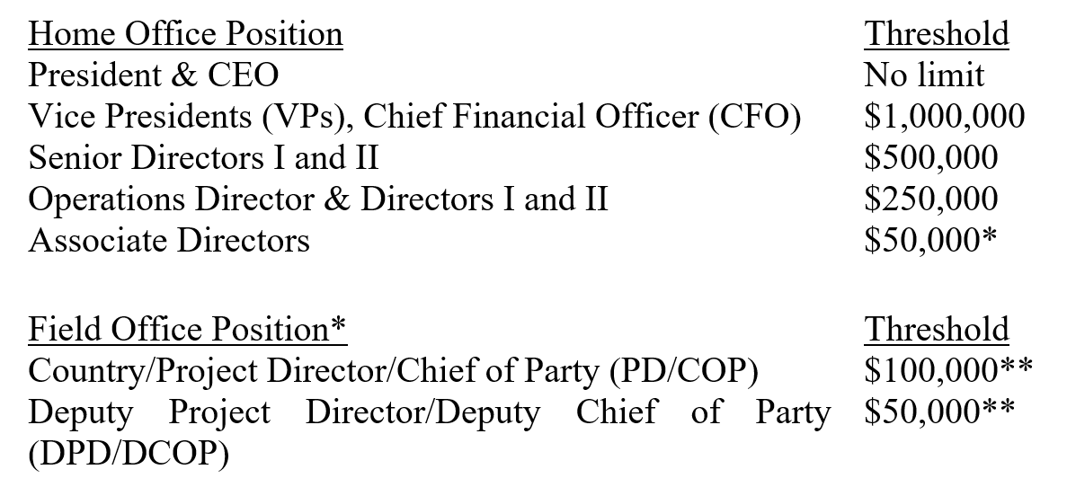
New DOA Limits
Authorization to sign payment requests, procurements, cover sheets, and contracts/grants in USD:
Notes:
Content Slide

Slide 3

Exceptions
*Associate Directors will provide approvals where DPDs/DCOPs are not available or when thresholds are lowered below $50,000.
**On case-by-case basis with approval from the Senior VP of Programs, the limit may be reduced to a minimum of $10,000 for PD/COPs an $5,000 for DPD/DCOPs.
Limit based on performance and compliance with POA policies.
Will include requirements necessary to adjust thresholds upwards.
In Colombia, all payment requests, procurements, cover sheets, and contracts/grants can be signed by Leonardo up to $250,000.
COPs/DCOPs should sign up to their limits, and anything above up to $250,000 signed by Leonardo.
Notes:
Content Slide

Slide 4


Next Steps
Create spot check criteria for contracts and procurements
Update training modules on POA policies (i.e. contracts, procurement, etc.)
Define who from each unit/team will serve as the compliance reviewer
Train delegated compliance reviewer
Develop accountability framework for compliance
Framework will be incorporated in an update to the DOA policy
Framework will have impact on performance and merit increases annually
Committee to develop accountability framework
2 home office, and 2 field staff
Want to volunteer? – Email Debbie and Danielle
Target goal for updated policy: 6 weeks – by June 1
Notes:
Content Slide

Slide 5







Thank you!
Notes:
Closure Slide

